Slide 1
Particle Theory
… a lead into chemistry

Slide 2
What is particle theory?
All matter is made of small particles (tiny pieces of the same substance or element)
Particles in a substance are attracted to each other, but do not touch.
The spaces between particles are large, relative to the size of the particles.
Particles are always moving (in motion), and with more energy, their motion increases
Particle theory provides an explanation for observed events in science, but is only a theory and may change as more information and research becomes available.

Slide 3
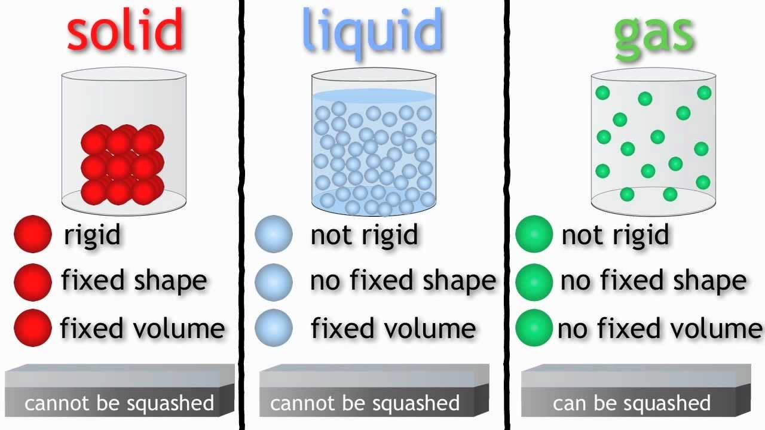
Different types of Materials have different particle properties

Slide 4
Substances and Mixtures
Matter: Anything that has mass and takes up space. Write three examples of matter, and give 2 examples of things that are NOT matter: _____________________________________________________
Pure Substance: Any Solid, liquid or gas that contains only one kind of particle. Examples: ______________________________________
Raw Material: Unprocessed material of any kind. Example: ______
Mixture: Any substance that contains at least two pure substances. Give 2 examples: ___________________________________________
Heterogeneous Mixture: An uneven mixture that contains two or more substances. I may have different properties. This can also be called a mechanical mixture. Example: _________________________
Homogeneous Mixture: A mixture that is the same throughout, samples from this type of mixture will have the same properties. This mixture can also be called a solution. Example: __________________

Slide 5
Substances and Mixtures… cont
Dissolved: When one substance has completely been mixed with another in a solution. Give an example:
Solute: The substance that dissolves in a solution.
Solvent: The substance into which the solute dissolves.
Concentration [ ] : The amount of solute dissolved in a given quantity of solvent or solution.
Dilute solution: Solutions with a low concentration
Concentrated solution: Solutions with a high amount of solute
Unsaturated solutions: Solutions which still contain spaces between solvent particles.
Saturated solutions: A solution that has all the spaces filled

Slide 6
Substances and mixtures cont…
Solubility: The maximum amount of a particular solute that can be dissolved in a particular solvent at a given temperature.
Super Saturated Solution: A solution that contains more of the solute then would be found in a saturated solution.

Slide 7
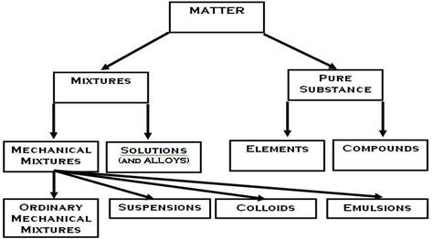

Slide 8
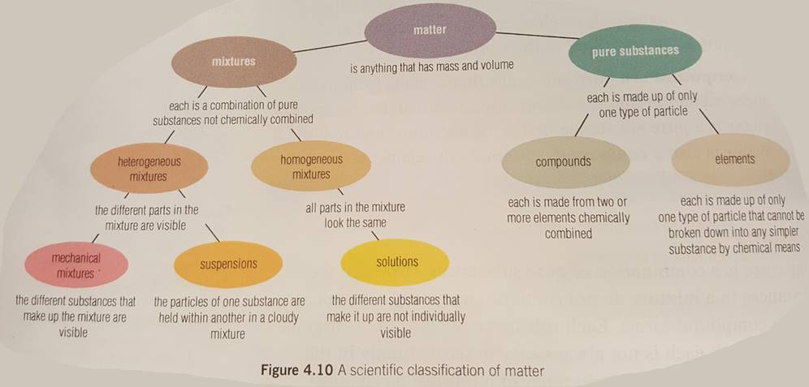

Slide 9
Your Job is to make different types of mixed crystal drinks of different strengths.
Follow the definitions to make each type of drink
When you are finished:
How could you get more solute into the same amount of solvent? What would have to change? We will try this out next class!
Complete a Lab write up for your idea. (Follow the green sheet)

Slide 10
Classifying materials.
Classify each material as Homogenous or heterogeneous and explain why:
Honey
Yogurt with fruit
Marshmallow
Raisin bread
Orange juice with pulp
Vanilla ice cream
Concrete sidewalk
Plastic Cup
Ketchup
Sand

