Slide 1
Poetry
5 styles of poems, their origin and tips

Slide 2
Why do we write and read poetry?
Self Expression
Stress Relief
Capture a historic period in a highly emotional way
Connect with others
Remember moments in life
Say a lot, with a little

Slide 3
What is poetry?
literary work in which special intensity is given to the expression of feelings and ideas by the use of distinctive style and rhythm; poems collectively or as a genre of literature

Slide 4
Some key terms before you begin writing / reading poetry
Stanza
Rhyme Scheme
Meter
For example: Iambic Pentameter
Couplet (Rhyming Couplet)
Syllable
Literary devices
Simile, metaphor, repetition, imagery, connotations, alliteration, onomatopoeia, hyperbole, personification …
two lines that have the same meter or rhyme. Together, the two lines usually make up a complete thought.
"The time is out of joint, O cursed spite.
That ever I was born to set it right!" - Hamlet
Similar to how sentences make up a paragraph, a group of lines make up a stanza. A stanza is usually named based on the number of lines it contains.
Rhyme scheme refers to the pattern of rhymes at the end of each line. It's annotated with letters. For example, a four-line stanza with an ABAB rhyme scheme means the first and third lines rhyme and the second and fourth lines rhyme
The number of vowel sounds in a word.

Slide 5
5 types of poems: Haiku Limerick Ode Sonnet Free Verse / Narrative

Slide 6
Haiku

Slide 7
Haiku
An old silent pond... A frog jumps into the pond, splash! Silence again
- m. basho
A haiku poem has three lines, where the first and last lines have five moras (Syllable), and the middle line has seven. The pattern in this Japanese genre is 5-7-5. The lines of such poems rarely rhyme with each other.
Traditionally Haiku's describe nature, are serene and calming

Slide 8
Marriage is a Con
Tract between two adults of
Different Families

Slide 10
Haiku: Simple structure, makes it a favourite
Even though Haiku traditionally reference nature, are calm and serene, they can hold a powerful image in an understated way.
The simplicity of the form makes them popular in media, and they can be very funny, or allow for a greater impact.
Just because Haiku are traditionally about specific topics, does not mean that you must follow that structure.

Slide 11
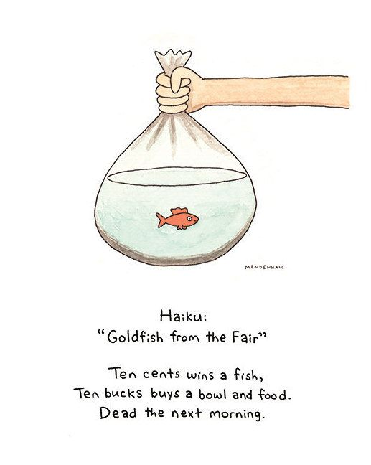
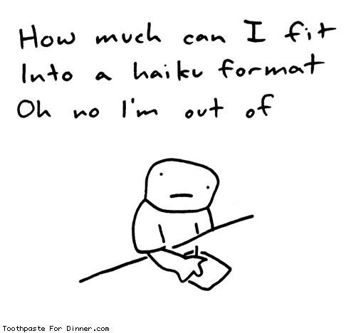
It's Like, we're looking
Down on Wayne's Basement, only
That's not Wayne's Basement
- Garth (Wayne's World)
Thermea is closed
Where will I go to relax?
The couch? No thank you
- Tyler Magz (Hot 103.1 Virgin Radio Winnipeg, March 16th 2020

Slide 12
Create 2 Haiku poems for submission: On must be using traditional themes and topics One must be about a current situation to capture a moment You can create as many as you would like, but you must share a minimum of 2.

Slide 13
Limericks

Slide 14
Limerick
The origins of the Limerick are unknown, but Edward Lear (1818-1888) is considered the father of the Limerick after popularizing these short silly rhyming poems.
The Limerick is a five lined poem, with an AABBA rhyme scheme. The "A" lines tend to be longer (7-10 syllables) and rhyme with each other, while the "B" lines are shorter (5-7 syllables) and rhyme with each other.

Slide 15
Limerick Format
Limerick Example:
https://100xhahaha.com/joke_a6e36208_sr

Slide 16
Limerick Format
Limerick Example:
https://100xhahaha.com/joke_a6e36208_sr

Slide 17
Limerick Format
Limerick Example:
https://100xhahaha.com/joke_a6e36208_sr

Slide 18
Limerick Format
Limerick Example:
https://100xhahaha.com/joke_a6e36208_sr

Slide 19
Limerick Format
Limerick Example:
https://100xhahaha.com/joke_a6e36208_sr

Slide 20
Even Sponge bob Loves Limericks!

Slide 21
Limerick Prompts You can use any opening line you would like, but if you have trouble getting started, try a prompt! Feel free to change it up if you wish!
There once was a fat cat named Boots...
Acadia's Principal, Troy Scott...
You'd know you were from Winnipeg if...
There once was a(n) ADJECTIVE - NOUN from PLACE:
(replace the underlined words)

Slide 22
Write 2 limerick Poems for submission: One can be about anything The other MUST be about a current event, or situation you are in

Slide 23
Odes

Slide 24
The History and Facts about Odes
Ode is a form of lyrical poetry, in which poets use a certain metrical pattern and rhyme scheme to express their noble and lofty sentiments in serious and sometimes satirical tone.
Originated in Greece, and were originally sung
There are three different types of odes: Pindaric, Horatian, and Irregular
Resurfaced in Elizabethan times 17th and 18th century

Slide 25
Examples of Odes
Gary Soto:
Neighborhood Odes
Mi Gato
John Keats
Ode to a Nightingale (Pindaric Ode example)

Slide 27
How to write an Ode
1)Select a topic of something that you truly LOVE! This is where an amazing Ode is born! Sometimes, the little obscure things make the best Odes – Like and old pair or running shows, the way your cat stretches, the dew on a piece of grass, or something small and unique to your school, classroom, or home make the best odes!
2) Brainstorm many things that you love about that one person, place or thing. Try to get as many things as possible. It should be easy to come up with at least10 ideas, since it is something you love dearly
3) For each item, re-write it using descriptive language. Use similes, metaphors. Alliteration, hyperbole, onomatopoeia, personification.
4) Think of the different senses, Taste, touch, sound, sight and smell. Describe your item that uses all 5 senses! (Use literary devices to help with this!)
5) Rearrange your sentences into an order that sounds good to you, or has another meaning to you. You can re-work some sentences to try a rhyming Ode as well.

Slide 28
Assignment
Write an ode.
It can be serious or satirical (like, an ode to Donald TrumP)
You must include a minimum of one of each of the literary devices. And the Ode must include all 5 senses.

Slide 29
Sonnets

Slide 30
What is a Sonnet?
a poem of fourteen lines using any number of formal rhyme schemes, in English typically having ten syllables per line.
The word sonnet is derived from the Italian word “sonetto,” which means a “little song” or small lyric.
sonnets often use iambic pentameter: five sets of unstressed syllables followed by stressed syllables for a ten-syllable line
Sonnets were invented by the Italian poet Giacomo da Lentini during the 1200s

Slide 31
Writing a Sonnet
You need to consider Rhythm, rhyme and Content

Slide 32
Try writing the rhymes using the following rhyme scheme
A)
B)
A)
B)
C)
D)
C)
D)
E)
F)
E)
F)
G)
G)

Slide 33
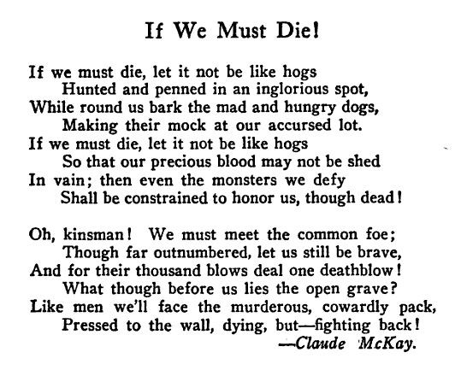

Slide 34
Free Verse / Narrative

Slide 35
Free Verse vs Narrative
Free Verse
Narrative
No Rules. Free verse poems do not follow the rules, and have no rhyme or rhythm; but they are still an artistic expression
Poems that tell a story
From rhythmic ballads to long epics to short narrative poems

Slide 36
Favourite Narrative Poems
The Raven – Poe
Casey at the Bat – Thayer
Cremation of Sam McGee - Robert Service
The Charge of the Light Brigade - Tennyson
Many songs that tell a story fit in this category too!
- Fatima (K'naan)
Hurricane (Bob Dylan)
- Wheat Kings (Tragically hip)
Which Poems do you know of that tell a story?

Slide 37
Writing Free Verse/ Narrative
Consider poetic language:
Imagery, Word Choice, Literary devices (metaphors, simile, aliterations, onomateopiea, repetition, etc...)
Write about something that is really important to you!
Don't be afraid to think outside of the box!

